Slide 1
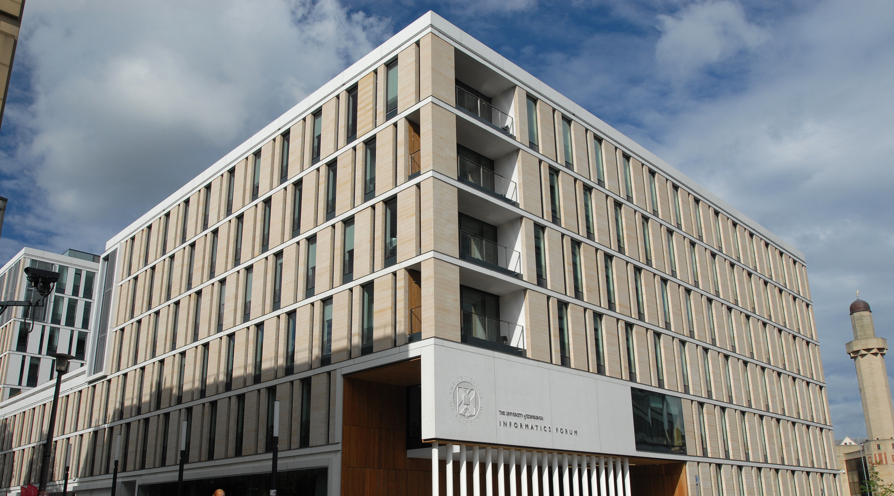
Lecture 1 Part 1: IPP Overview Informatics Project Proposal (IPP) 2022/2023
Aurora Constantin
Based on and adapted from earlier versions by Björn Franke Mark van Rossum, Alan Bundy, Victor Lavrenko, Stratis Viglas

Slide 2
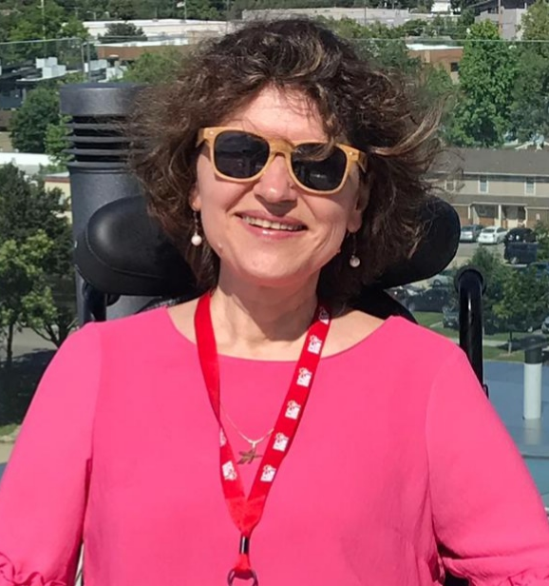
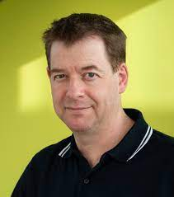
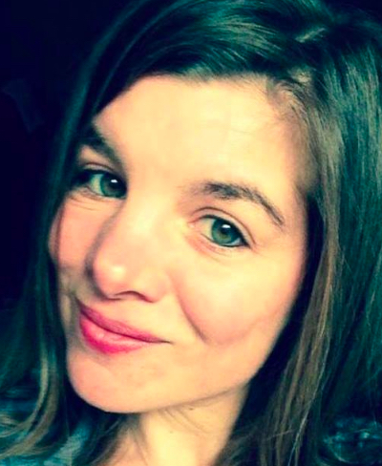

Core IPP Course Team
Dr Aurora Constantin
Course Organiser
(aurora.constantin@ed.ac.uk )
Prof Douglas Armstrong
(douglas.armstrong@ed.ac.uk)
Peggy Seriès
(pseries@inf.ed.ac.uk)
David Caulton
(david.caulton@ed.ac.uk)

Slide 3
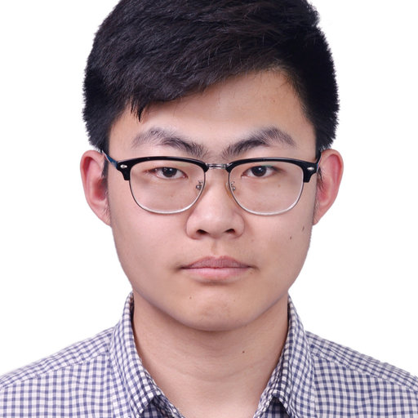
Core IPP Course Team
Xingran Ruan
Teaching Assistant
(x.ruan-3@sms.ed.ac.uk)
and
IPP Tutors

Slide 4
Content
1 Your MSc Programme
2 Motivation
3 Goals

Slide 5

Your MSc Programme
Taught component (100 credits)
Lectures, tutorials, courseworks, exams
Learn established techniques that work
Research component (80 credits)
Do something that has never been done before
Study a new problem, develop a new method, etc.
Probably the most exciting (and hardest) part of MSc
Dissertation (60 credits , 20-40 pages)
Two courses prepare you:
IRR: literature review in your broad area of interest (10 credits)
IPP: write a detailed plan for your specific MSc project (10 credits)

Slide 6
MSc Project Timeline
Semester 1 (IRR)
Learn about a relevant area: explore research papers
Write a 10-page critical review of what you learned
Project Proposals
Fri, 20 Jan 2023: deadline for all project proposals, including self-proposed projects
Wed, 25 Jan 2023– Fri, 10 Feb 2023: Talk to supervisors, pick set of topics
algorithmic allocation
Semester 2 (IPP)
write a detailed research plan for what you’re going to do (CW, 100%)
Summer (provided you progress to the dissertation stage)
Work on your project (design, build, test, analyse results)
Write a dissertation – 18 Aug 2023
Timetable: https://www.inf.ed.ac.uk/teaching/courses/diss/timetable.html

Slide 7


Slide 8


Slide 9
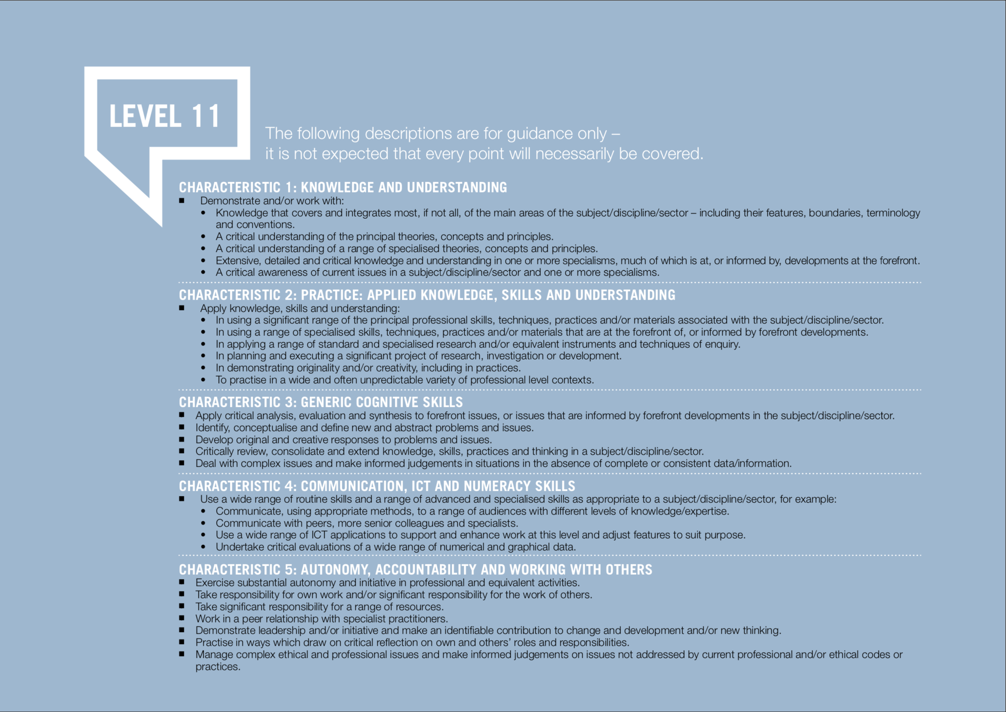

Slide 10
IRR vs IPP
IRR | IPP
Literature Review | Your Project Proposal/Plan
Coursework – assessed by tutors | Coursework – assessed by project supervisor
Mandatory tutorial groups | Mandatory tutorial groups & meetings with supervisor!

Slide 11

Goals
Learn skills of project planning
Confirm choice of (research) project area
Scope out your summer project

Slide 12
Further IPP Goals
Knowing what to work on is a big part of research
Motivation is identifying a void in the literature, or a real-world problem that has not been solved.
Coming up with a feasible way to address the problem.
Propose ways of evaluating the techniques.
Present expected outcomes succinctly and objectively.
Important skills
For PhD applications
For grant writing
For industry project proposals

